Slide 1


Thesis Proposal | Hanne Oberman | 4216318 | MSBBSS | Utrecht University
Supervised by Prof. Dr. Stef van Buuren, & Dr. Gerko Vink
ShinyMICE:
an Evaluation Suite
for Multiple Imputation

Slide 2
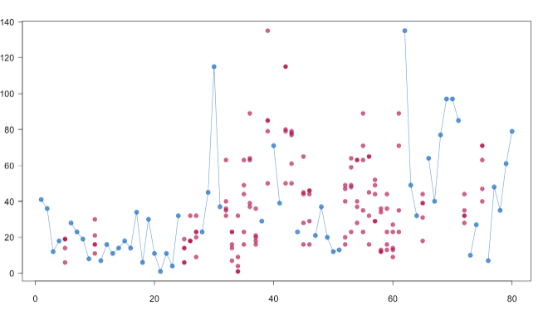
Multiple Imputation
Legend:
Observed
Imputed
Outcome (Y)
Time (days)
Notes:
Almost all (social) scientific research copes with missingness (source?). Ignoring missing data can yield wildly
invalid inferences (Van Buuren (2018)). A solution is provided by multiple imputation (MI; Rubin (1987)).
This technique – that is growing in popularity (Van Buuren (2018)) – entails completing a data set with
missingness several times. The variability between these completions en-captures the uncertainty of the
inferences due to missingness (Rubin (1987)).
The R package MICE (Multiple Imputation using Chained Equations; Van Buuren and
Groothuis-Oudshoorn (2011)) is the world-leading software for multiple imputation (Van Buuren (2018)).
However, the package currently does not provide user-friendly means to evaluate the multiply imputed data.
Therefore, the goal of this project is develop a MICE evaluation suite, featuring existing modules (like plots
to compare the incomplete and completed data sets), and novel assessment tools (like a measure to assess
algorithmic convergence). The practical relevance of this research project is in facilitating applied researchers
in making valid inferences despite of missingness. Moreover, it contributes to the scientific literature because
there is not yet a clear-cut way of diagnosing convergence for MICE algorithms.

Slide 3
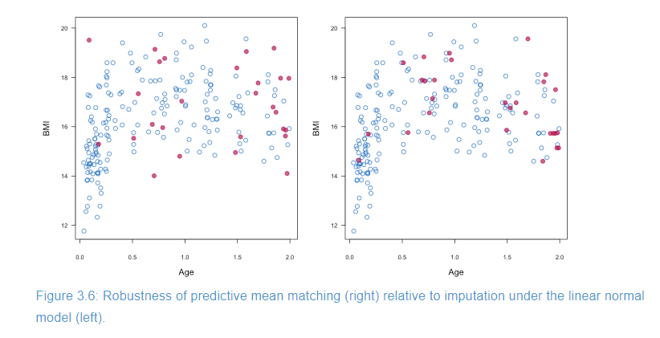

Slide 4
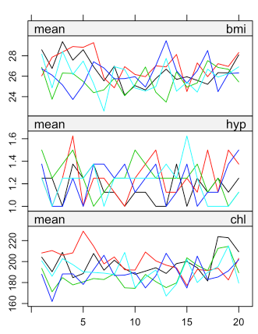
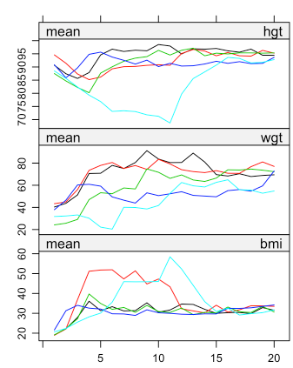
Algorithmic Convergence
Legend:
- 1st imputation
- 2nd imputation
- 3rd imputation
- 4th imputation
- 5th imputation
Iteration number
Iteration number
Notes:
Currently, “there is no clear-cut method for determining when the MICE algorithm has converged” (Van
Buuren (2018), §6.5). Instead, users have to rely on visual inspection of the algorithm’s iterations.
Convergence is said to be reached when the parameters (like means of completed variables or regression
coefficients) are stable over iterations (White, Royston, and Wood (2011)). Additionally, convergence requires
the variance between the several imputation chains to be no larger than the variances within each chain (Van
Buuren (2018)). According to Li et al. (2014) the latter is conceptually similar to the Gelman-Rubin statistic.
The Gelman-Rubin statistic (Gelman and Rubin (1992)), however, assumes independence between chains.
Therefore, it cannot be directly applied to compare imputations that share the same incomplete data
(source??).
Notwithstandlingly, it seems like Su et al. (2011) did implement the Gelman-Rubin statistic as convergence
criterion into their R package ‘mi’, including the conventional cut-off of 1.1. It is worth investigating its
validity in the context of MICE’s convergence, and the broader framework of fully conditional specification
(FSC) algorithms.
The most recent literature on the topic states that convergence properties of FCS algorithms are still under
debate (Takahashi (2017)), with the specific case of a MICE procedure like predictive mean matching posing
an entirely open question (Murray (2018)). Van Buuren (2018) summarizes this problem as follows: “No
method works best in all circumstances. The consensus is to assess convergence with a combination of tools.
The added value of using a combination of convergence diagnostics for missing data imputation has not yet
been systematically studied” (Van Buuren (2018), §6.5). And that is exactly the gap in the scientific
literature that this thesis will contribute to.

Slide 5
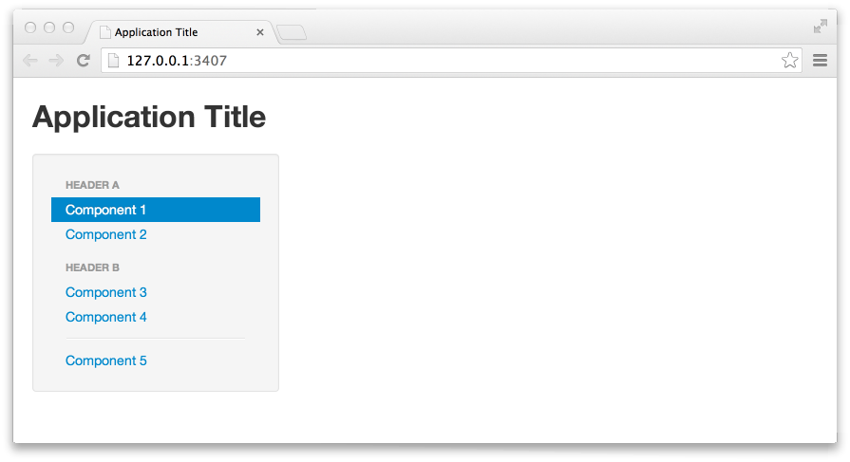
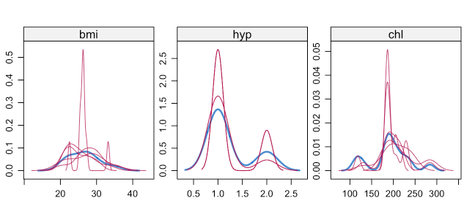
R Shiny Application
: ShinyMICE
Observed ( ) versus imputed ( ) marginal density
Notes:
(Chang et al. (2019)) to program a web-browser based local app for the evaluation of multiply imputed data:
‘ShinyMICE’.
The research report that is to be handed in December 13th 2019 will consist of an investigation into
algorithmic convergence of MICE. Ideally, this will result in a single indicator to flag non-convergence
(potentially based on the Gelman-Rubin statistic, autocorrelation, or MC error).
The second stage of the research project is of more practical nature: programming ShinyMICE. The
application will at least consist of the following: 1) one or more measures to assess algorithmic convergence;
2) data visualizations (e.g., scatterplots, densities, and cross-tabulations of the data pre- and
2
post-imputation); and 3) statistical evaluation of relations between variables pre- versus post-imputation (i.e.,
chi square tests or t-tests). This part of the thesis also entails research into user interface (UI) design, local
versus cloud-based data storage, and optimizing the application’s efficiency.
A working beta version of ShinyMICE will be considered sufficient to proceed to the next step: writing a
technical paper on the workings and usage of the software. Possible journals for publication of this
manuscript are The R Journal and Journal of Statistical Software.
Finally, the shinyMICE package will be integrated into the existing MICE environment, and a vingette for
applied researchers will be written.
Ethical consent (if you ‘touch’ the data).

Slide 6
References
Chang, Winston, Joe Cheng, J. J. Allaire, Yihui Xie, Jonathan McPherson, RStudio, jQuery Foundation
(jQuery library and jQuery UI library), et al. 2019. Shiny: Web Application Framework for R (version 1.3.2).
https://CRAN.R-project.org/package=shiny.
Gelman, Andrew, and Donald B. Rubin. 1992. “Inference from Iterative Simulation Using Multiple
Sequences.” Statistical Science 7 (4): 457–72. https://doi.org/10.1214/ss/1177011136.
Li, Fan, Michela Baccini, Fabrizia Mealli, Elizabeth R. Zell, Constantine E. Frangakis, and Donald B. Rubin.
2014. “Multiple Imputation by Ordered Monotone Blocks with Application to the Anthrax Vaccine Research
Program.” Journal of Computational and Graphical Statistics 23 (3): 877–92.
https://doi.org/10.1080/10618600.2013.826583.
Murray, Jared S. 2018. “Multiple Imputation: A Review of Practical and Theoretical Findings.” Statistical
Science 33 (2): 142–59. https://doi.org/10.1214/18-STS644.
Rubin, Donald B. 1987. Multiple Imputation for Nonresponse in Surveys. Wiley Series in Probability and
Mathematical Statistics Applied Probability and Statistics. New York, NY: Wiley.
Su, Yu-Sung, Andrew E. Gelman, Jennifer Hill, and Masanao Yajima. 2011. “Multiple Imputation with
Diagnostics (Mi) in R: Opening Windows into the Black Box” 45 (2): 1–31.
https://doi.org/10.7916/D8VQ3CD3.
Takahashi, Masayoshi. 2017. “Statistical Inference in Missing Data by MCMC and Non-MCMC Multiple
Imputation Algorithms: Assessing the Effects of Between-Imputation Iterations.” Data Science Journal 16
(0): 37. https://doi.org/10.5334/dsj-2017-037.
Van Buuren, Stef. 2018. Flexible Imputation of Missing Data. Chapman and Hall/CRC.
Van Buuren, Stef, and Karin Groothuis-Oudshoorn. 2011. “Mice: Multivariate Imputation by Chained
Equations in R.” Journal of Statistical Software 45 (1): 1–67. https://doi.org/10.18637/jss.v045.i03.
White, Ian R., Patrick Royston, and Angela M. Wood. 2011. “Multiple Imputation Using Chained Equations:
Issues and Guidance for Practice.” Statistics in Medicine 30 (4): 377–99. https://doi.org/10.1002/sim.4067.

